Slide 1

Amazon Sales Analysis
By: Uzman Ansari
Email : uzman786ansari@gmail.com

Slide 2

Amazon Company and Sales Analysis A comprehensive overview of Amazon's business and sales performance
Introduction to Amazon
Sales Performance Overview
Revenue Growth: Annual revenue trends
Highlight key milestones and growth phases
Overview: Brief history and founding of Amazon
Founded by Jeff Bezos in 1994
Initial focus on online book sales
Expansion into a wide variety of product categories
E-commerce: Amazon.com platform
Amazon Web Services (AWS): Cloud computing services
Other Ventures: Amazon Fresh, Whole Foods, Amazon Go, and more

Slide 3

Problem Statement
Objective
Sales management has gained importance to meet increasing competition and the need for improved methods of distribution to reduce cost and to increase profits. Sales management today is the most important function in a commercial and business enterprise.
Overview: This presentation provides a detailed analysis of Amazon's sales data from 2010 to 2017. The analysis focuses on identifying key metrics and trends using advanced machine learning models.
The need for improved distribution methods, cost reduction, and profit maximization has never been greater.
Tools & Libraries
Solutions to Enhance Sales Management
Data Analysis: Python
Data Visualization: PowerBI
Libraries: Numpy, Pandas, Matplotlib, Seaborn
ML: sklearn, LinearRegression, RandomForestRegressor, KMeans
Data-Driven Sales Strategies:
Use predictive analytics to forecast sales trends and identify potential opportunities and risks.
e-learning platforms and interactive training modules to keep sales teams updated with the latest industry trends and best practices.

Slide 4

Analysis
Key Metrics
Total Revenue
Total Units Sold
Total Profit
Total Cost
Revenue by Region
Revenue by Item Type
Revenue by Sales Channel
Units Sold by Item Type
Processing Time
Profit Margin
Top selling items
Top selling regions
Top sales channels
Average order value
Attributes
Region: region where the order was placed
Country : where the order was placed
Item Type : Cosmetics, Baby Food, Office Supplies
Sales Channel : Online , Offline through sale was made
Order Priority : (C - Critical, H - High, L - Low, M - Medium)
Order Date: Which Date order was placed
Order ID : Unique identifier for each order
Ship Date: date when the order was shipped
Units Sold: Number of units sold in the order
Unit Price: Price per unit
Unit Cost: Cost per unit
Total Revenue:Total revenue generated from the order
Total Cost: Total cost from the order
Total Profit: Profit generated from the order.
Order Month: Month in which the order was placed, for seasonality analysis.
Order Year: Year in which the order was placed, for trend analysis.

Slide 5
Data Analysis

Slide 6
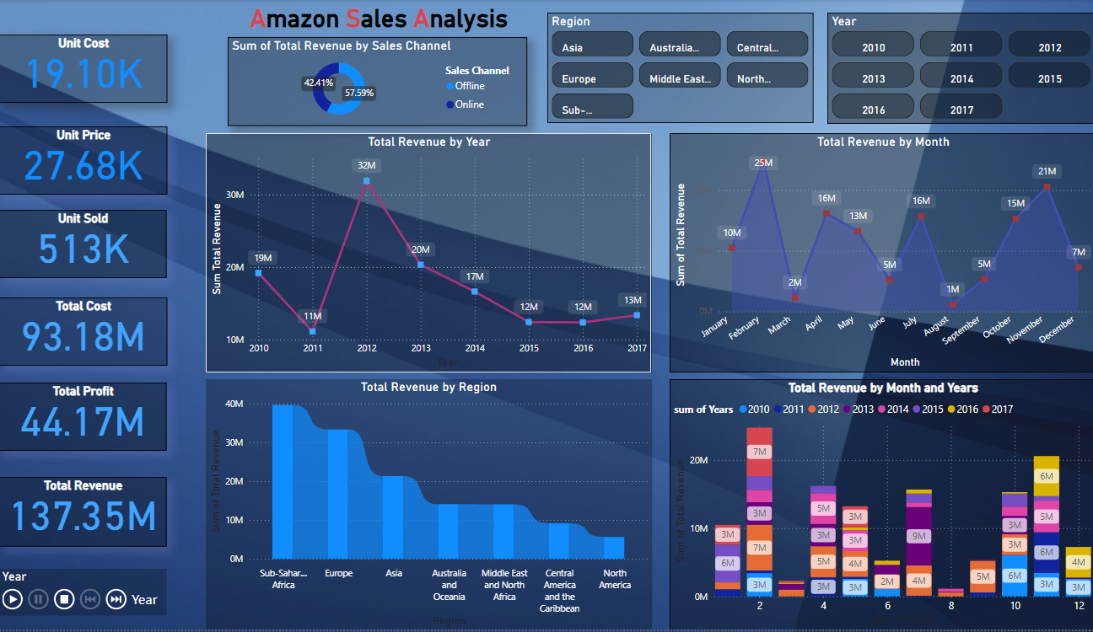

Slide 7
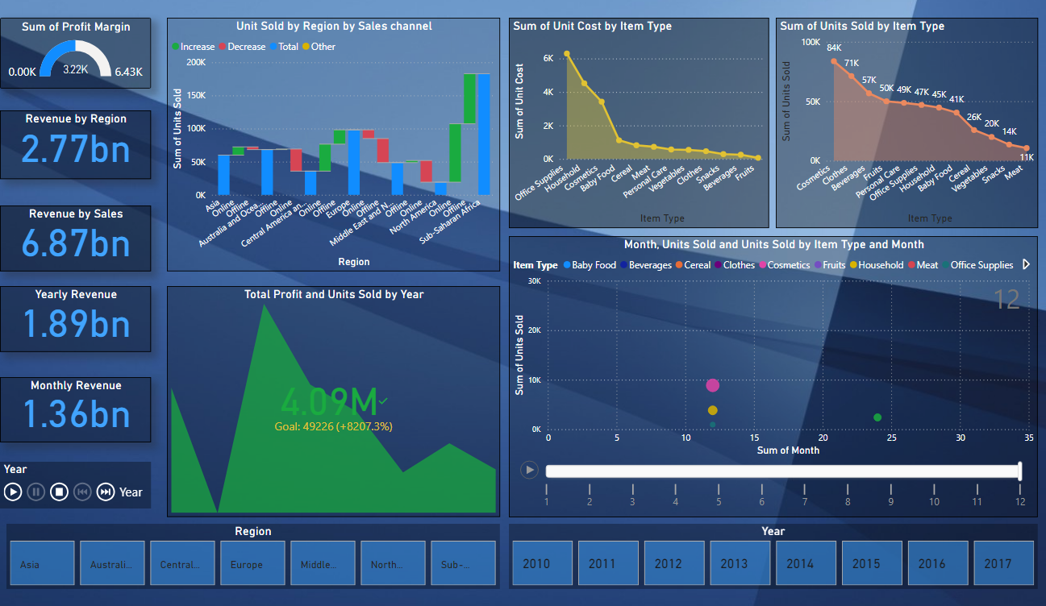

Slide 8
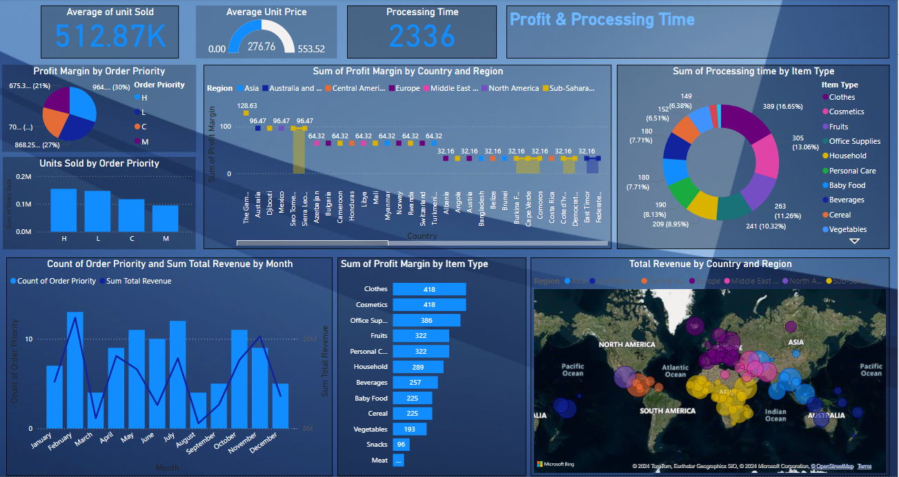

Slide 9
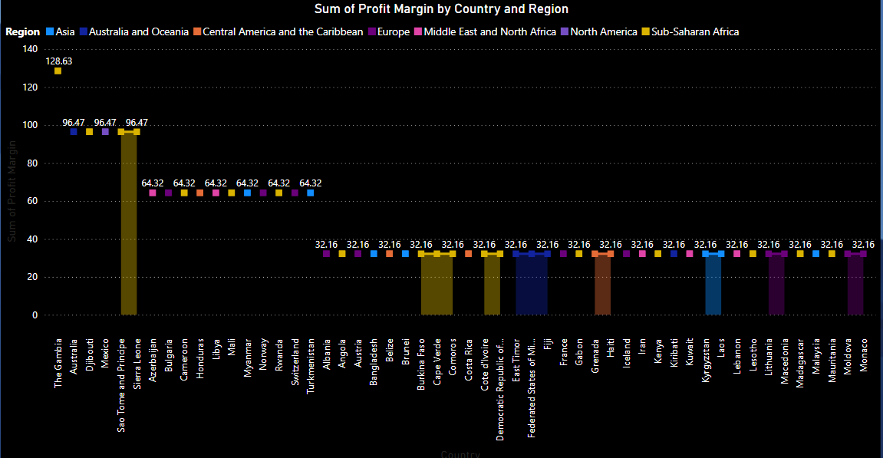
Profit Margin by Country and Region
By Country and Region:
Profit Margin by Country:
Cosmetics lead in revenue (36.60M) but have a moderate profit margin (39.77%)
Clothes combine high profit margin (67.20%) with substantial revenue (7.79M), making them highly profitable
Fruits ($0.47M) and have lower revenues but maintain modest profit margins (25.8%

Slide 10
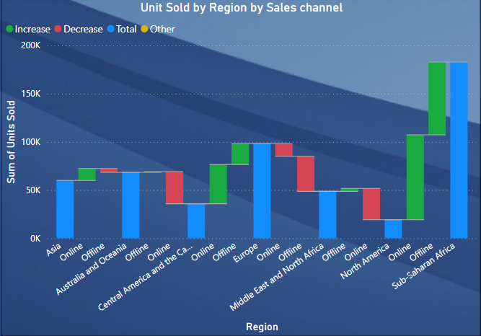
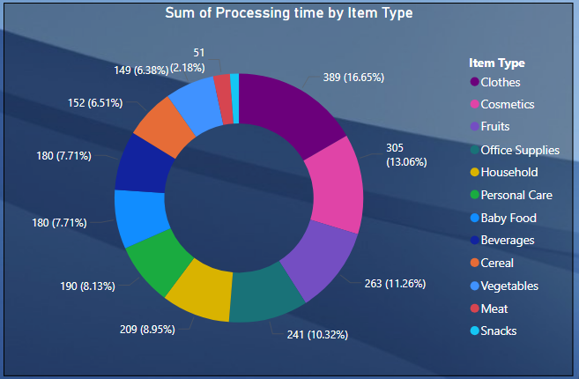
Unit Sold by Region by Sales channel
Sum Of Processing time by Item Type
Breakdown of units sold by region and sales channel (online and offline)
Identify Data Source: Ensure you have a dataset that includes columns for Item Type and Processing Time.
Filter Data: Extract rows corresponding to the specified item types:
Cosmetics 13.06 %
Clothes 16.65%
Household
Care
Baby Food
Meat
Snacks
Aggregate Data: Sum the processing times for each of the specified item types.

Slide 11
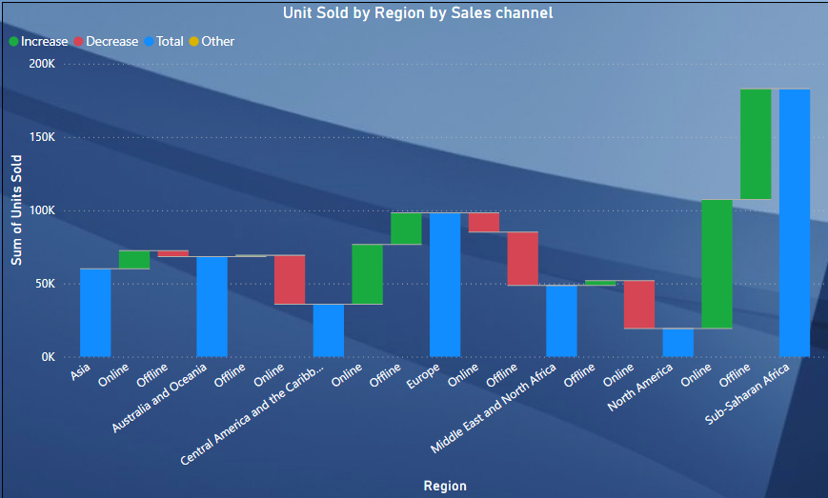
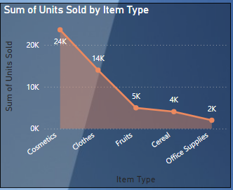
Unit Sold by Region by Sales channel
Sub-Saharan Africa 443.61M Revenue are the Top Customer
Sub-Saharan Africa and Europe : Leads in offline and online sales.
Europe 320.36M Revenue
Central America And The Caribb.. 100.1M Revenue
North America 60.98M Revenue
Middle East Top Cosmetic Customer
Office Supplies is lowest

Slide 12
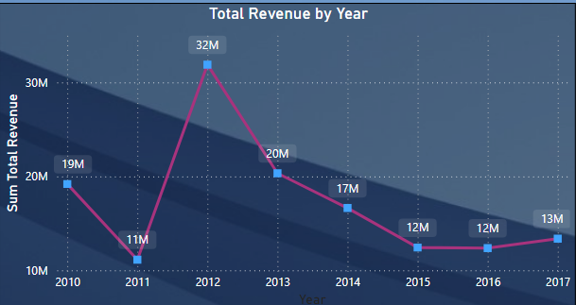
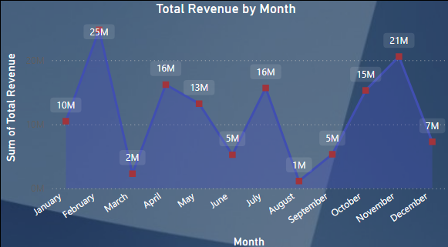
Sales Overview
Total Revenue by Years
Total Revenue: 137.35M
Total Units Sold : 513K
Total Profit : 44.17M
Total Cost : 93.18M
- Revenue highest in 2012 at 32M
- Revenue lowest in 2011 at 11M
fluctuations observed in subsequent years.
Total Revenue by Month
February and November
indicating seasonality in sales.
- Revenue lowest in August 1M
- Revenue in February 25M and November 21M

Slide 13
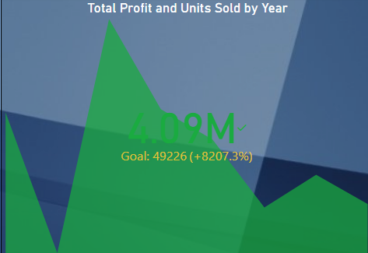
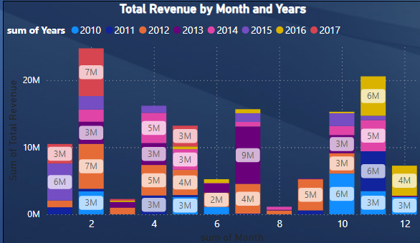
Total Profit and Units Sold by Year
By taking ,Total profit, Unit Sold And Year
4.09M Goal: 49226(+8207.3%)
Revenue in the 2nd month 2012 and 2017 ,7M
Revenue in the 11th month 2014 and 2016 , 5M, 6M
Revenue in the 7th month 2013 , 9M

Slide 14
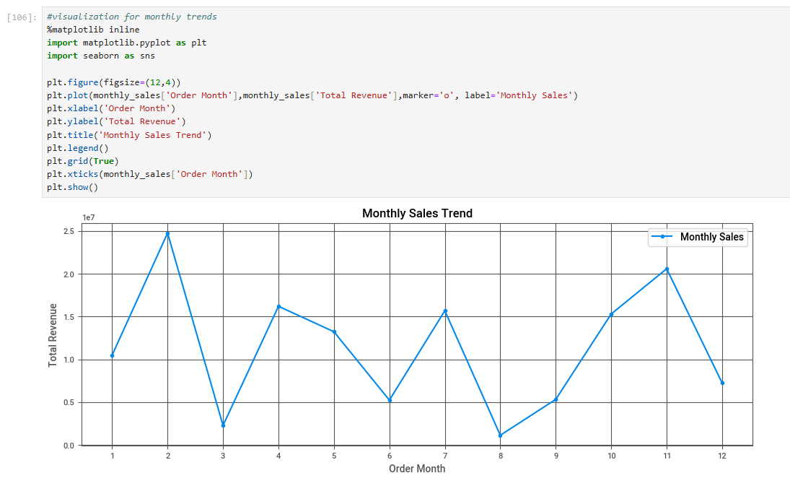
Monthly Sales Trend

Slide 15
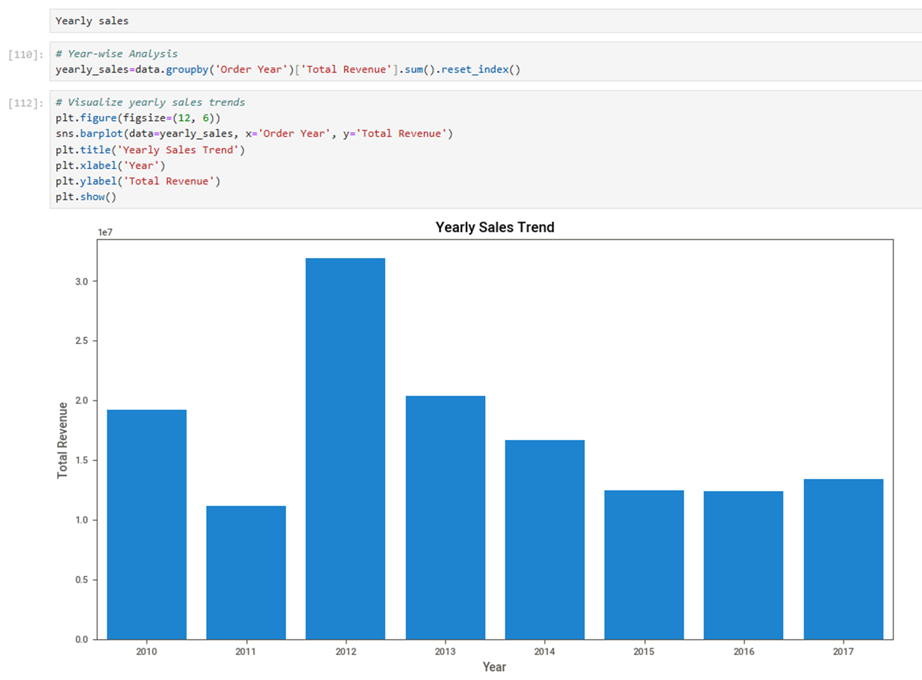
Yearly Sales Trend

Slide 16
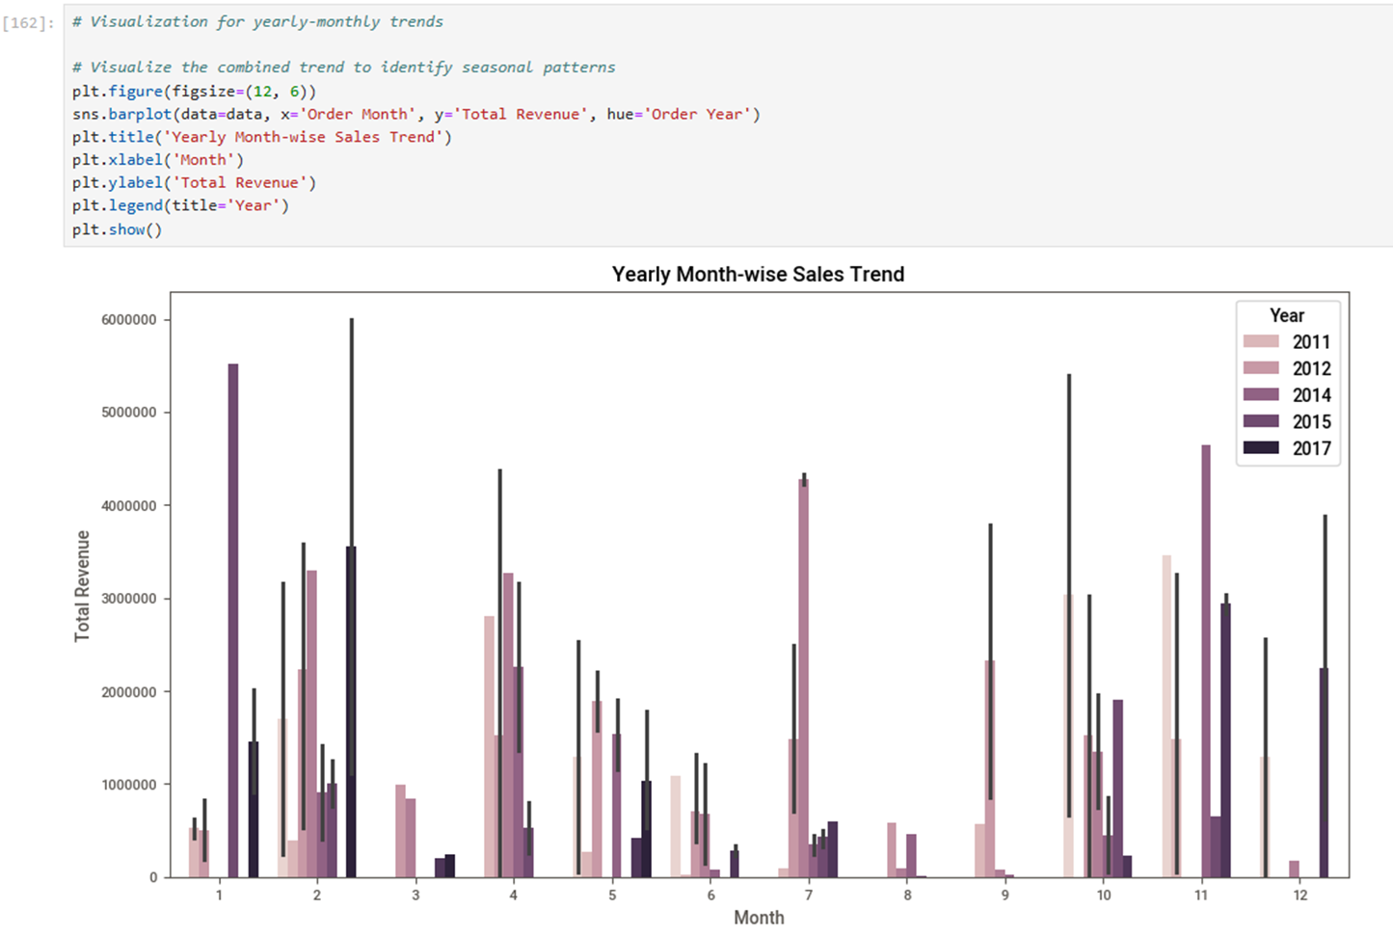
Yearly Month wise Sales Trend Month-wise Sales Trend

Slide 17
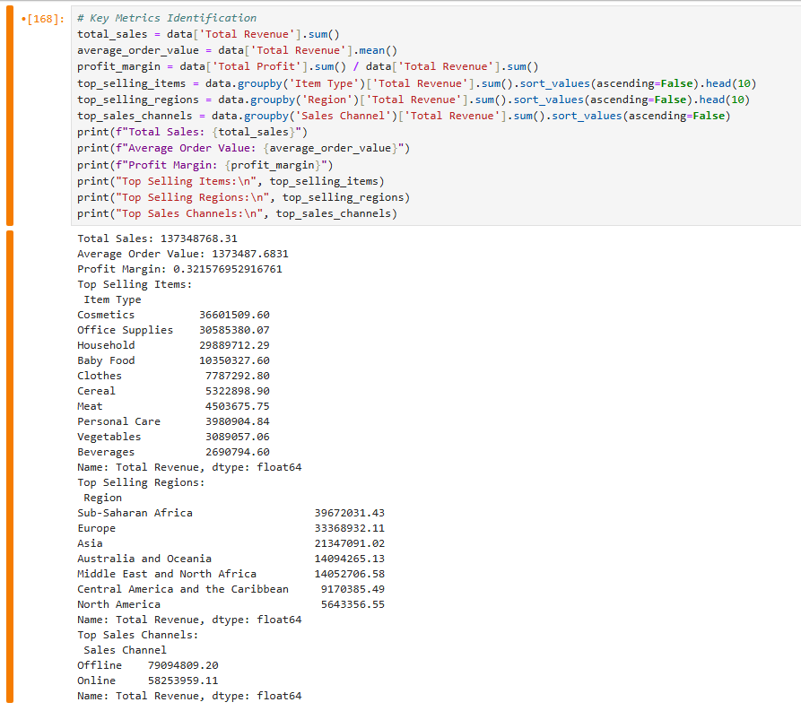
Key Metrics Identification

Slide 18
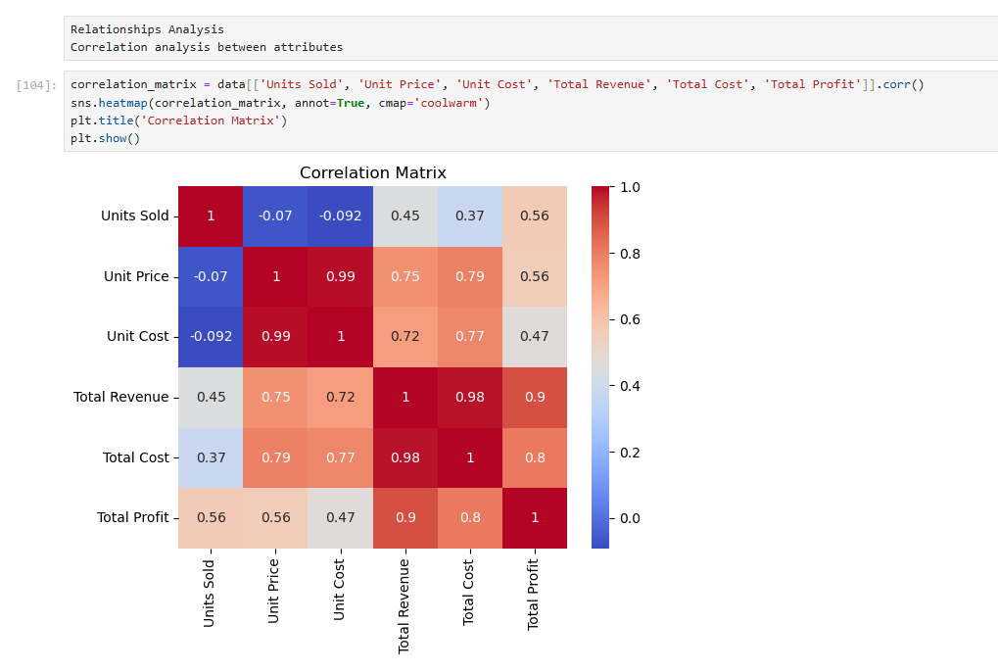

Slide 19

Thank You!

Slide 20

Data Visualization of Bird Strikes
Presented By: Uzman Ansari

Slide 21

Introduction
Bird strikes, defined as collisions between birds and aircraft, present a significant threat to aviation safety. These incidents occur when an aircraft in flight or during take-off or landing comes into contact with birds or other wildlife, such as bats or ground animals. Bird strikes are a common phenomenon and can lead to severe consequences, particularly for smaller aircraft where the impact can cause substantial structural damage.

Slide 22
Identify Trends and Patterns: Yearly Analysis: Analyse the number of bird strikes reported each year to identify any increasing or decreasing trends. Temporal Patterns: Determine the time of day, seasons, and specific months when bird strikes are most frequent.
Record ID
Aircraft: Type
Airport: Name
Altitude bin
Aircraft: Make/Model
Wildlife: Number struck
Wildlife: Number Struck Actual
Effect: Impact to flight
Flight Date
Effect: Indicated Damage
Aircraft: Number of engines?
Aircraft: Airline/Operator
Origin State
When: Phase of flight
Conditions: Precipitation
Remains of wildlife collected?
Remains of wildlife sent to Smithsonian
Remarks
Wildlife: Size
Conditions: Sky
Wildlife: Species
Pilot warned of birds or wildlife?
Cost: Total $
Feet above ground
Number of people injured
Is Aircraft Large?

Slide 23
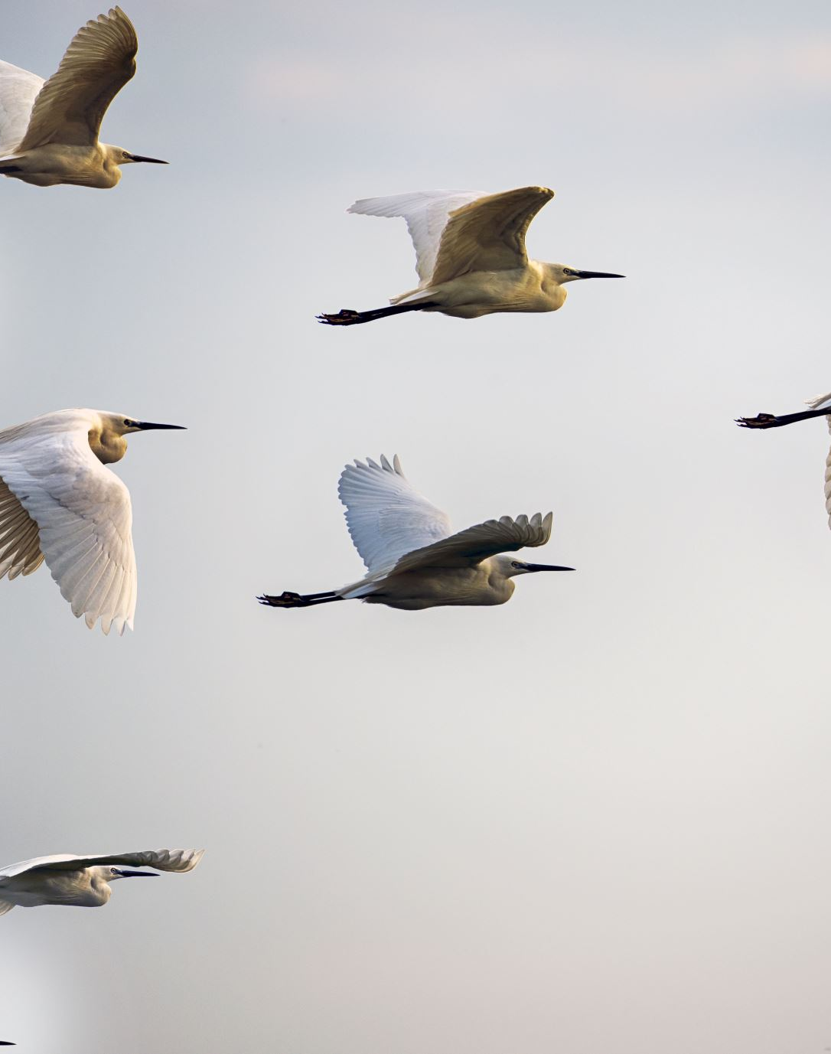
Bird Strikes between 2000 – 2011
Case Studies
Visuals Depicting the Number of Bird Strikes
Yearly Analysis & Bird Strikes in the US
Top 10 US Airlines in terms of having encountered bird strikes
Airports with most incidents of bird strikes – Top 50
Yearly Cost Incurred due to Bird Strikes:
When do most bird strikes occur?
Altitude of aeroplanes at the time of strike
Phase of flight at the time of the strike.
Average Altitude of the aeroplanes in different phases at the time of strike
Effect of Bird Strikes & Impact on Flight
Effect of Strike at Different Altitude
Were Pilots Informed? & Prior Warning and Effect of Strike Relation

Slide 24
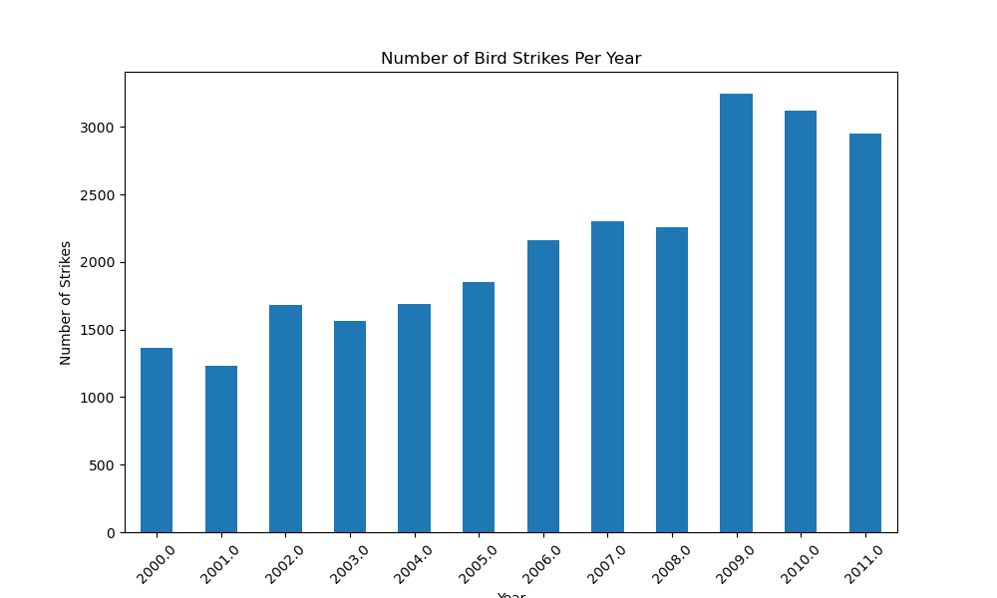
Number of Bird Strikes Per Year
Highest:
2009: This year has the highest number of bird strikes.
2010: This year has the second-highest number of bird strikes.
Lowest:
2001: This year has the lowest number of bird strikes.
2000: This year has the second-lowest number of bird strikes.

Slide 25
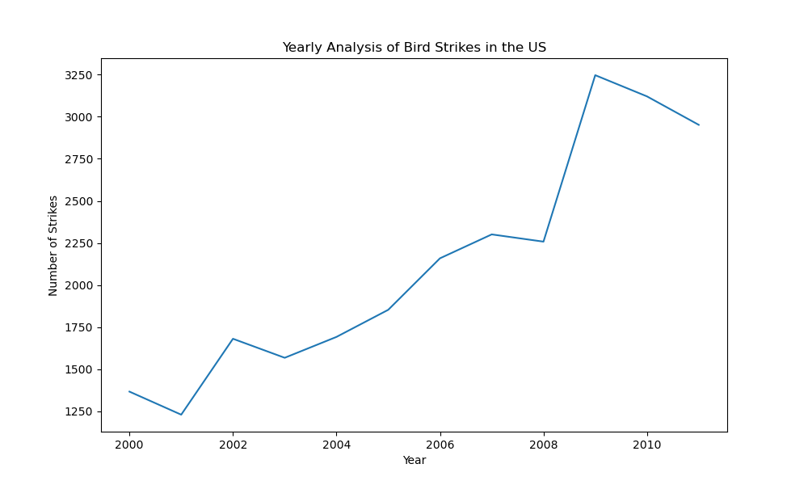
Yearly Analysis of Bird Strikes in the US
Peak 2009 as 3250 aprox

Slide 26
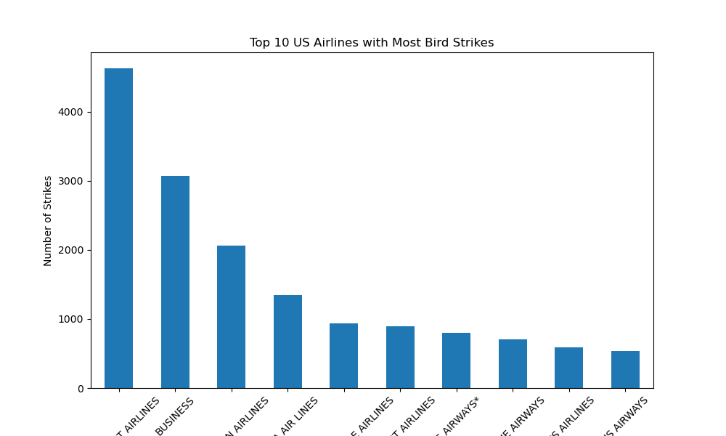
Top 10 US Airlines with Most Bird Strikes
SOUTHWEST AIRLINES
BUSINESS AIRLINES

Slide 27
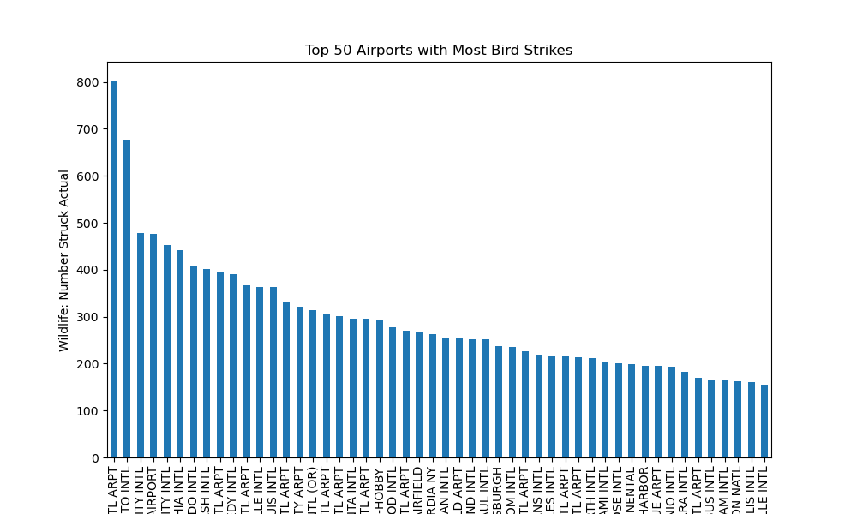
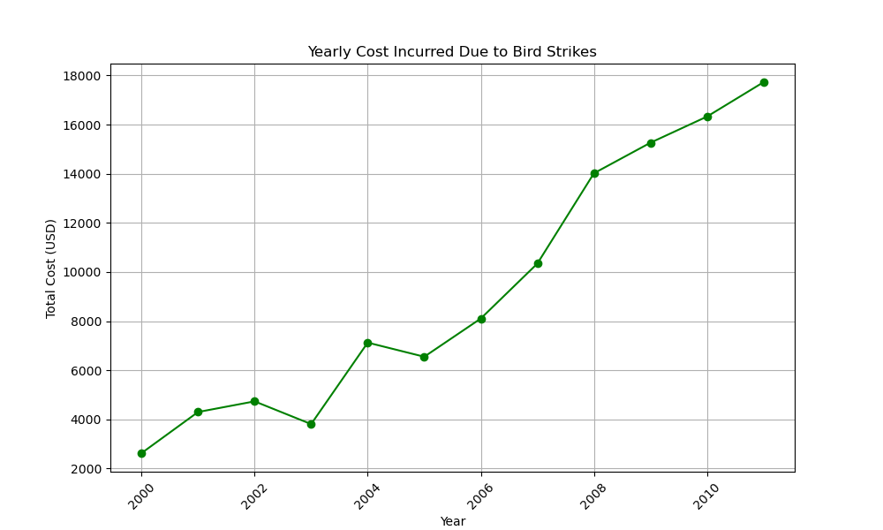
Yearly Cost Incurred Due to Bird Strikes
Top 50 Airports with Most Bird Strikes
TOP AIRPORTS: DALLAS/FORT WORTH INTERNATIONAL, SACRAMENTO INTERNATIONAL

Slide 28
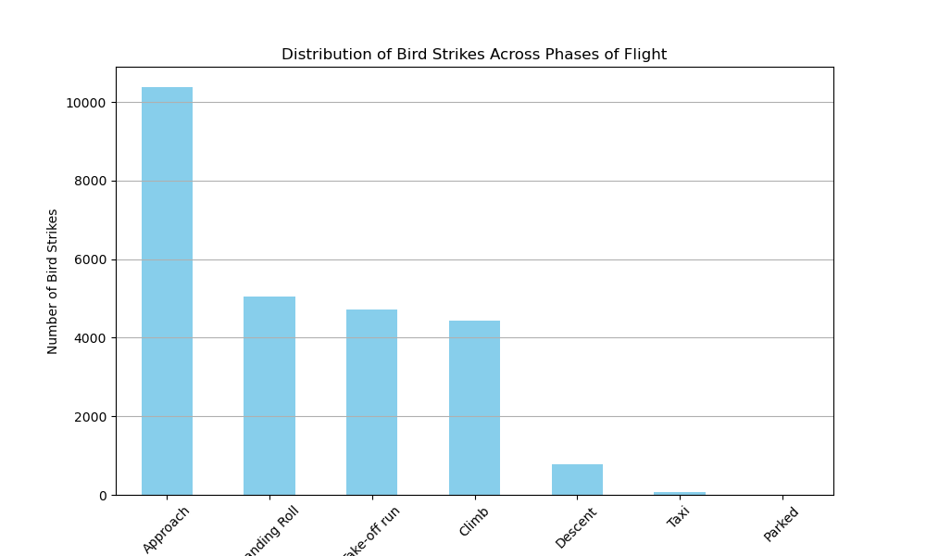
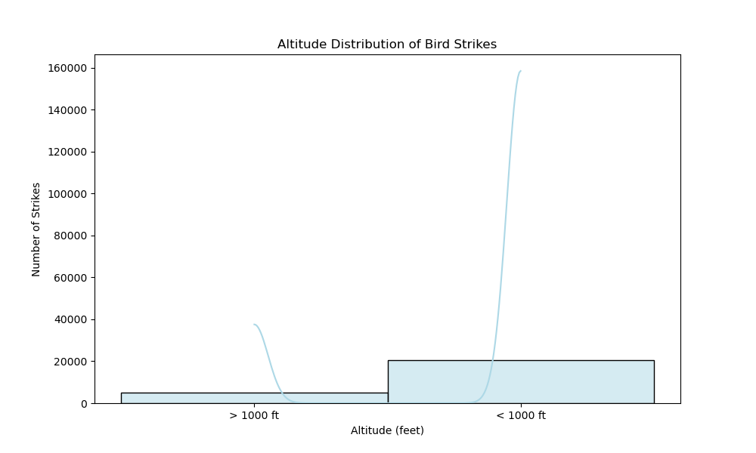
Highest: The "Approach" phase has the highest number of bird strikes, with nearly 10, 000 strikes. Lowest: The "Taxi" phase has the lowest number of bird strikes, with just over 1,000 strikes.
< 1000 ft: This category has the highest number of bird strikes, with nearly 160,000 strikes.
> 1000 ft: This category has significantly fewer bird strikes, with around 20,000 strikes.

Slide 29
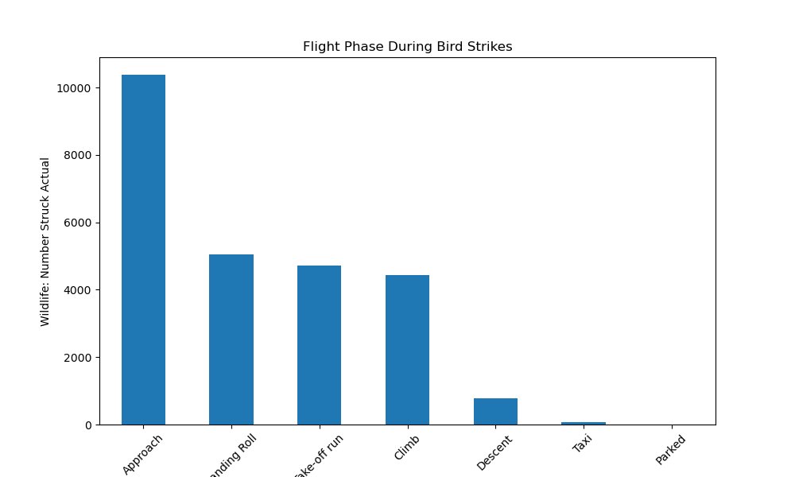
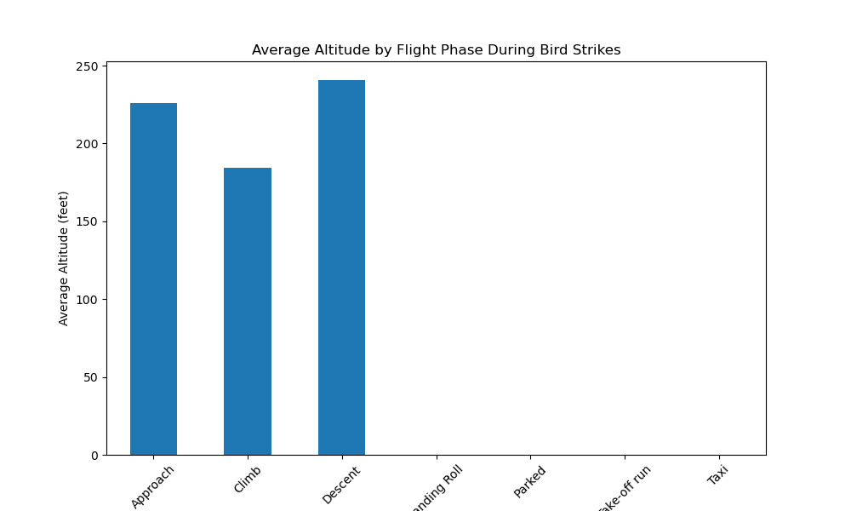
Approach: The Average Altitude During Bird Strikes In The Approach Phase Is Around 225 Feet.
Climb: The Average Altitude During Bird Strikes In The Climb Phase Is Approximately 180 Feet.
Descent: The Average Altitude During Bird Strikes In The Descent Phase Is About 240

Slide 30
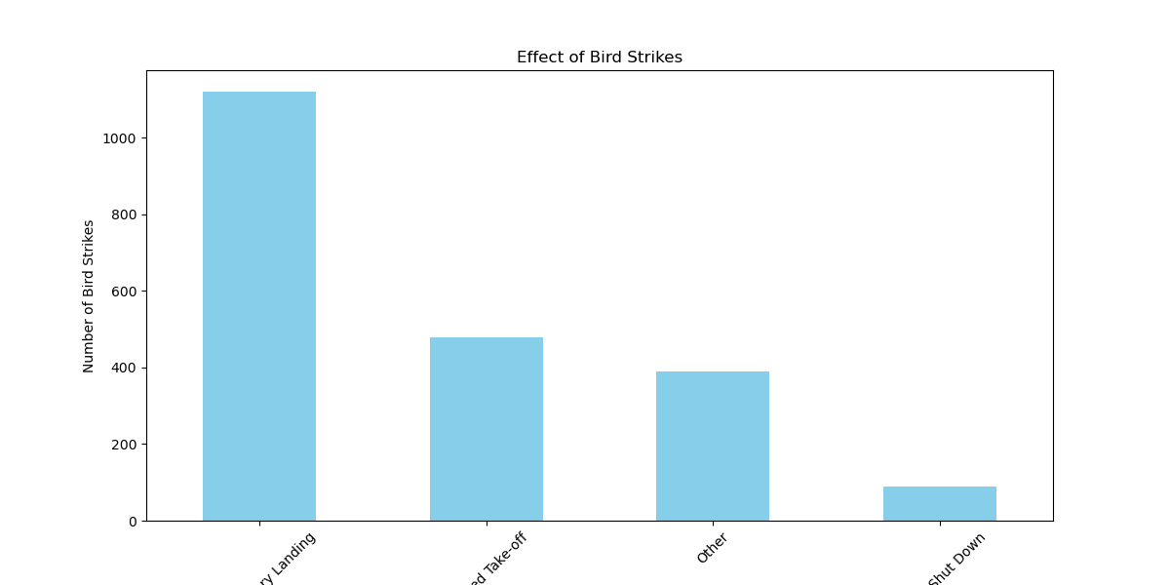
Highest:
Precautionary Landing: This category has the highest number of bird strikes.
Aborted Take-off. This category has the second-highest number of bird strikes.
Lowest:
Engine Shut Down. This category has the lowest number of bird strikes.
Other : This category has the second-lowest number of bird strikes.

Slide 31
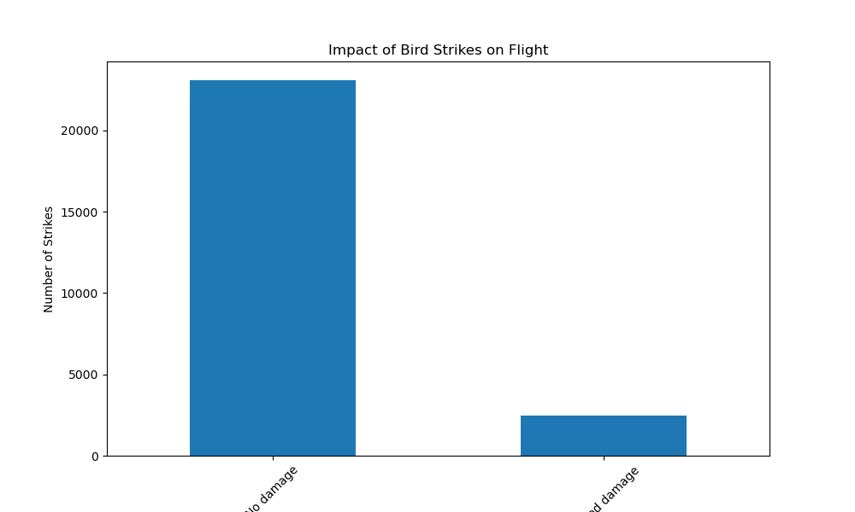
Impact of Bird Strikes on Flight
The Highest Number Of Bird Strikes, With More Than 20,000 Strikes. But No Damage
It Has A Significantly Lower Number Of Bird Strikes, With Less Than 5,000 Strikes Caused Damage.

Slide 32
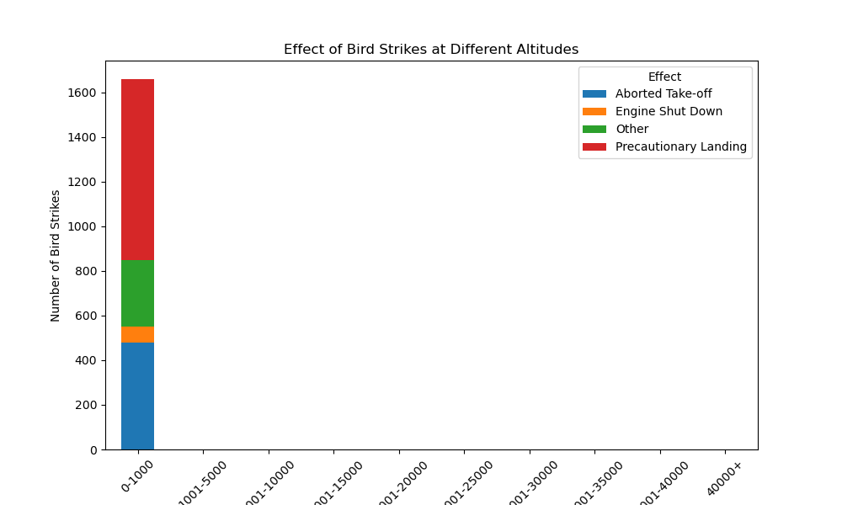
Effect of Bird Strikes at Different Altitudes
Aborted Take-off
Has more than 400 and range between 0 – 1000 Altitude Bin
Engine Shut Down
Has more than 400 and less than 600 range between 0 – 1000 Altitude Bin
Other
Has more than Equal 600 To more than 800 range between 0 – 1000 Altitude Bin
Precautionary Landing
Has more than 800 To 1600 range between 0 – 1000 Altitude Bin

Slide 33
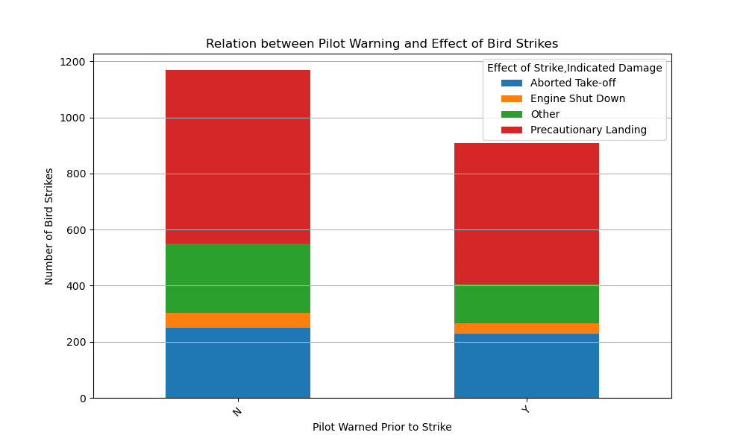
Relation between Pilot Warning and Effect of Bird Strikes
Aborted Take-off
N Has more than 0 more than 200 range
Y Has more than 0 To more than 200
Engine Shut Down
N Has more than 200 Less than 400 range
Y Has more than 200 To Less than 400
Other
N Has more than 200 Less than 600
Y Has more than 400 To more than 800
Precautionary Landing
N Has more than 600 To 1200
Y Has more than 400 To more than 800

Slide 34

Thanks, You

